Slide 1

A safe environment for our little ones
Capstone Project Phase B
Supervisor:
Aliza Attaly
Authors:
Daniel Khait
Boris Lasker
Notes:
D-In recent years we are hearing about more and more cases of abuse mainly in nurseries. The main reason for this is the lack of institutional supervision

Slide 2
Motivation
We created an AI model that can detect child abuse in nurseries and kindergartens using audio samples.
Abuse can last for months until it is discovered and sometimes not revealed at all.
There is a lack of supervision in kindergartens and nurseries.
Notes:
D

Slide 3
Government Supervision Act
In theory:
The Day Care Supervision Act enacted in 2018 was supposed to create a uniform standard for private early childhood settings, designed for ages 0-3.
In practice:
Out of about 10,000 private early childhood frameworks that operate, only 3,200 then applied for an operating permit under the Supervision Law.
Notes:
B-
Over the years there have been several attempts to eradicate the phenomenon.
One of the attempts was government oversight of the 0-3 age group.
Only about a third of the kindergartens are registered under this supervision ,
And the other two-thirds continue the activity without supervision and approvals.
So as we can see It did not solve the problem.

Slide 4
The law of cameras
In 2018, the Cameras Law was enacted, which requires the installation of cameras in kindergartens.
There are some problems with this law:
The people (parents) who are supposed to watch these footage can’t spend 6 hours a day staring at these surveillance cameras.
It is easy to miss abusive acts.
Notes:
B-Another attempt to eradicate the phenomenon was the Camera Act
The law requires every kindergarten to install a camera But there were problems with this solution
Firstly the parents are not able to watch the cameras all day
and secondly it is very easy to miss cases of abuse

Slide 5
Our Project
System that would always watch and hear what is happening in
the nurseries and detect abusive behavior.
System - multithreaded autonomic software. (Python / VSC)
AST - audio sample classification. (Python / VSC)
BabyShield - User’s android application. (Java / Android studio)
Notes:
B - Our project consists of 3 main components.
System - Autonomic system that connect to the cameras and microphones that are already installed in the nurseries. The system will create the suspicious video and upload it to the DB.
For the learning process, we will use the AST: Audio Spectrogram Transformer algorithm to detect the suspicious audio samples.
Lastly , application for the parents, where they can watch the uploaded videos.

Slide 6
AST: Audio Spectrogram Transformer
Convolution-free
Purely attention-based model
Audio classification
Pretrained model
Notes:
D-
Audio Spectrogram Transformer (AST),
It is a trainble model just like other neural network
So we have some features
a convolution-free- this is a layer that can be viewed as a single convolution layer with a large kernel and stride size.
purely attention based model- that is directly applied to an audio spectrogram and can capture long-range global context even in the lowest layers.
audio classification – our model will classify audio samples

Slide 7
The advantages of AST
AST has superior performance.
AST naturally supports variable-length inputs and can be applied to different tasks without any change of architecture.
AST converges faster during training compared with SOTA CNN attention hybrid models.
AST features a simpler architecture with fewer parameters.
Notes:
D- we evaluate AST on a variety of audio classification tasks and datasets including AudioSet, ESC-50 and Speech Commands . AST outperforms state-of-the-art systems on all these datasets.
Specifically, the models we use for all aforementioned tasks have the same architecture while the input lengths vary from 1 sec. (Speech Commands) to 10 sec. (AudioSet).
In contrast, CNN-based models typically require architecture tuning to obtain optimal performance for different tasks.

Slide 8
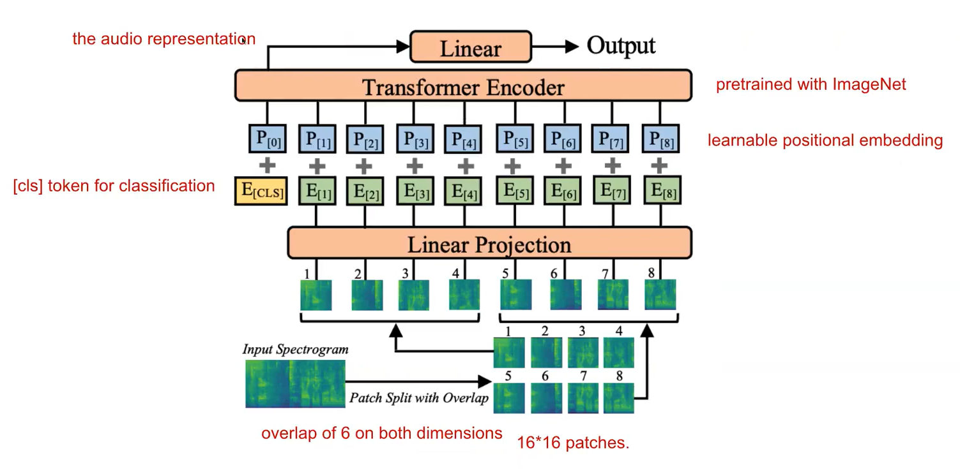
AST: Audio Spectrogram Transformer
Notes:
D-Here we can see the full architecture of the ast.
We will go through the architecture step by step and see how an audio semple becomes classified.

Slide 9
Dataset Constraint
Initial dataset - “donate a cry”.
Dataset size was not big enough.
More than half of dataset is only “hungry” classification.
Creative solution:
Capture more suspicious labels from the already pretrained model.
Notes:
B-
Initially, we trained our already pretrained model with “donate a cry” dataset. However the dataset was not big enough to influence the weight of the edges.
So our solution to that was utilizing the already pretrained model.
This model is allready trained on 520 different audio labels including some that we can use.

Slide 10
Creative solution
Capture more suspicious labels from the already pretrained model.
Here are few labels for example:
Baby cry
Shout
Female Screaming
Slap, smack
Crying, sobbing
Notes:
B

Slide 11
Multithreaded Autonomic System
Capture web camera and save frames.
Open audio channel and save audio samples.
Watcher on audio sample folder to enter AST.
AST
Create a suspicious video and upload to database.
Notes:
B-
So we have out system, each feature is on its own thread, so it all works simultaneously.
Firstly, the system captures the camera and saves timestamped frames.
It also records 15 seconds audio samples and stores them in a folder. This folder has a watcher that assincronicly takes each sample there and puts it in the AST.
If the sample is suspecious, another thread will merge a bunch of frames together creating a video, and also adding the audio to it,
Lastly, the video is uploaded to BD.

Slide 12
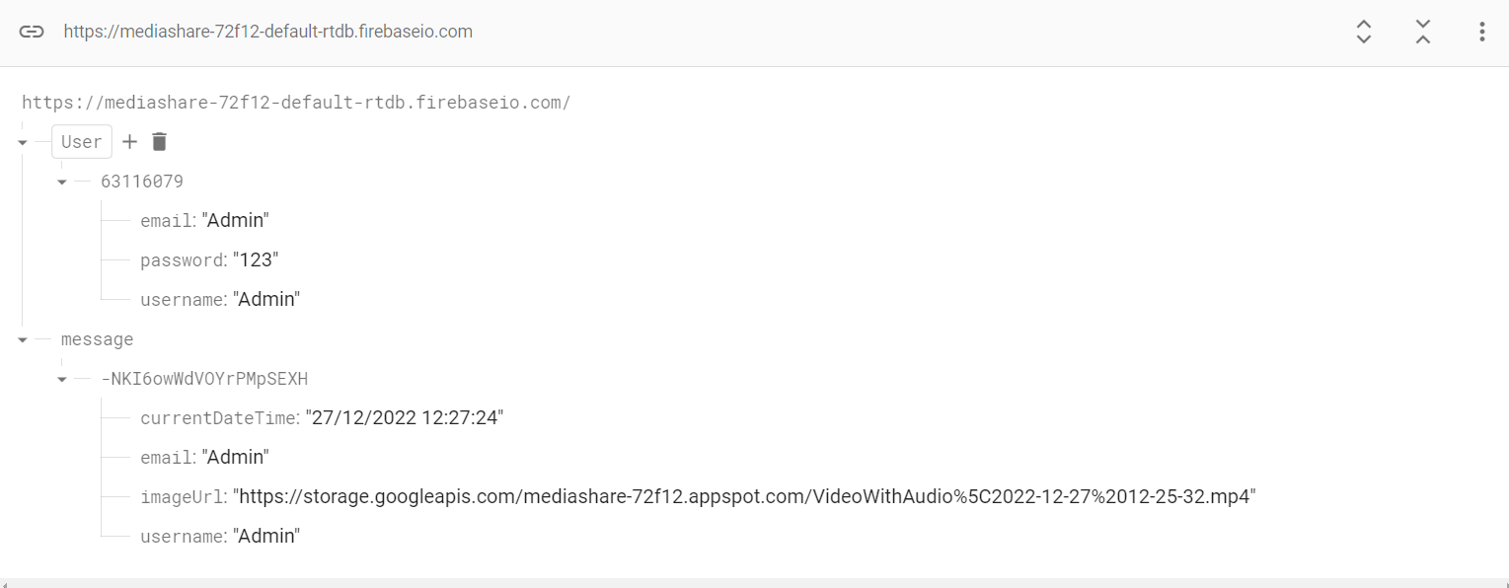
Database
Notes:
D-
We used Firebase as our database.
Our DB contains 2 Collections:
First collection is User , it has the following attributes.
Second collection is message, which is our created video.

Slide 13
Python Technologies
OpenCV
Watchdog
PyAudio
PyTorch
Firebase
Threading
Colab
MoviePy
Notes:
D-
OpenCV - for capturing the web camera, and saving frames and videos.
Watchdog- creating a watcher on a folder, so it does something when a new file is created in that folder.
Pyaudio- Used to record audio samples.
MoviePy - for merging a video with the audio.

Slide 14
System Challenges
Low camera fps
Python with firebase
Python version
AST input audio sample frequency.
Synchronizing the audio with the created video.
Notes:
D-
Challenges that arose during development:
During the development we encountered quite a few problems, and most of them we solved by various means.
When we creatred the thread of the camera - its job is to capture frames and save them in a folder, we saw that the camera saves only 10 frames per second, which of course is not enough for us. After a long search we discovered that the problem stems from an input command of the camera, which delays the work of the system. We added a separate thread whose role is to catch the last frame, so the system can work without waiting for input. The number of frames per second jumped from 10 to 140, a 14-fold improvement. Of course, we are satisfied with about 30 frames per second and we limited the system accordingly.

Slide 15
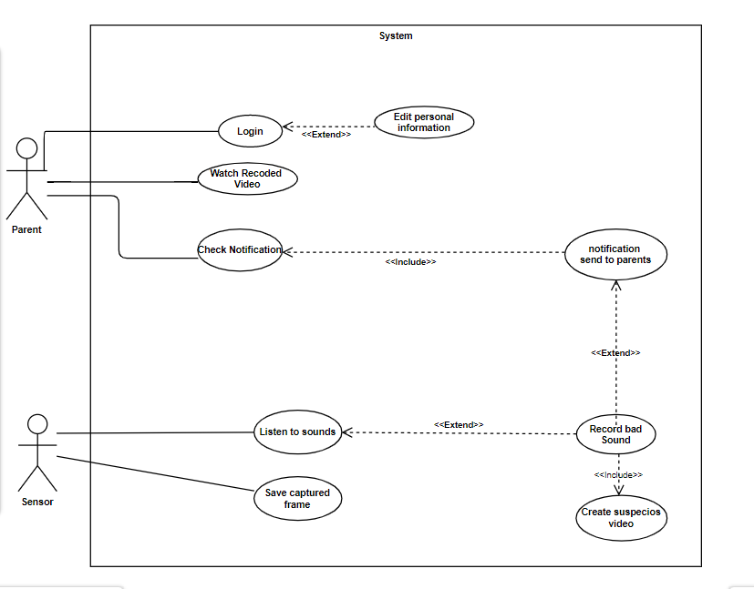
Use Case Diagram
Notes:
B

Slide 16
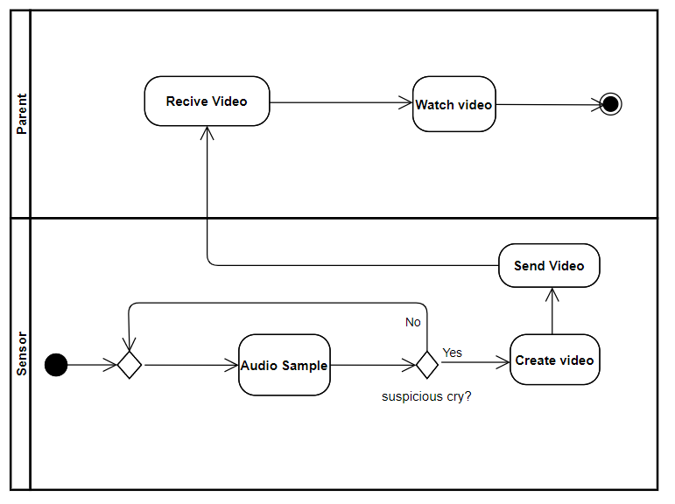
Activity Diagram
Notes:
B

Slide 17
BabyShield - User’s android application
Fully functional application with the following features:
Users able to register. (new feature)
Users can watch uploaded videos.
Users can delete a video.
Users receive a notification when a new video is uploaded.
Remember me check box for convenience.
Notes:
B-
We decided to add the register feature to make it a more complete application.

Slide 18
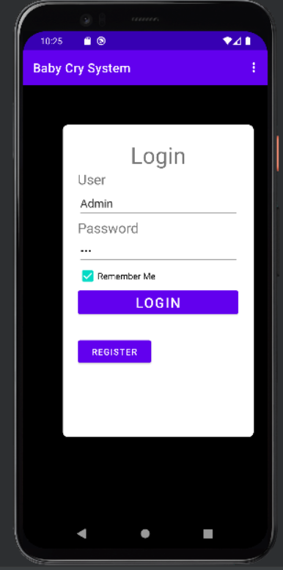
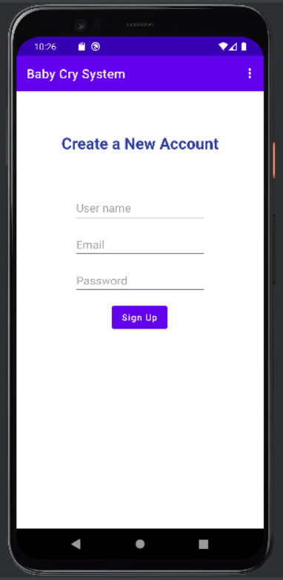
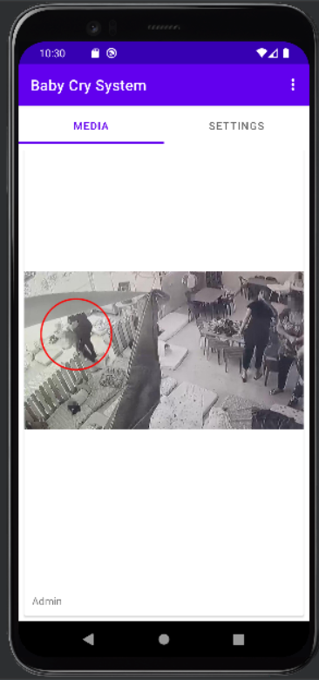
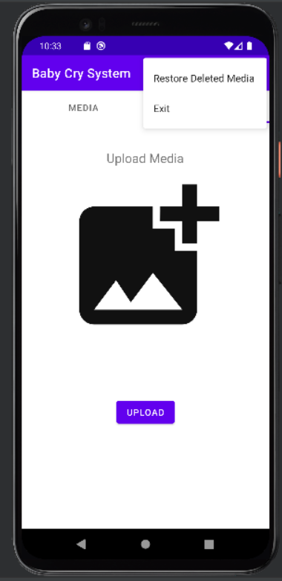
GUI
Notes:
B

Slide 19
Testing Plan
Test Number | Test Case | Expected Results
1 | When creating a video, frame not found. | The system will skip to the next frame in order.
2 | Video was not created. | System will print that video creation failed, and a new video next to the timestep will attempt to be created.
3 | Microphone does not record. | The system will send a message that the microphone doesn’t record
4 | Camera does not record. | The system will send a message that the camera doesn’t record
Notes:
B

Slide 20
Testing Plan
Test Number | Test Case | Expected Results
5 | The video is not created with audio. | The system will notify that the video is corrupted.
6 | Unable to open video. | In Application, a toast will pop up and say “There is a problem opening video please try again later ”
7 | If there is an attempt to sabotage the camera or microphone. | The system will send a message that the hardware was harmed
Notes:
B

Slide 21
Looking at the future
Future features:
Better performance and precision for the AST model.
Secure DB and encrypt user’s password.
Create a separate executable AST model.
Live camera stream on the App.
Multiple cameras and microphones.
Create a bigger scale DB for multiple nurseries.
Notes:
D
Main goal -almost achieved.
We managed to make the whole system work together, starting from the AST up ultill the GUI.
Most of our initial requirements were completed, however there are some features that we might add in the future.
Create a separate executable AST model.
Better performance in we run the ast on a different machine, or later we can even make it run on a cloud.

Slide 22
